Slide 1

S&P 500 emini Future Trading Strategy
Pham Tuan Phong
PhD in Finance – La Trobe University

Slide 2
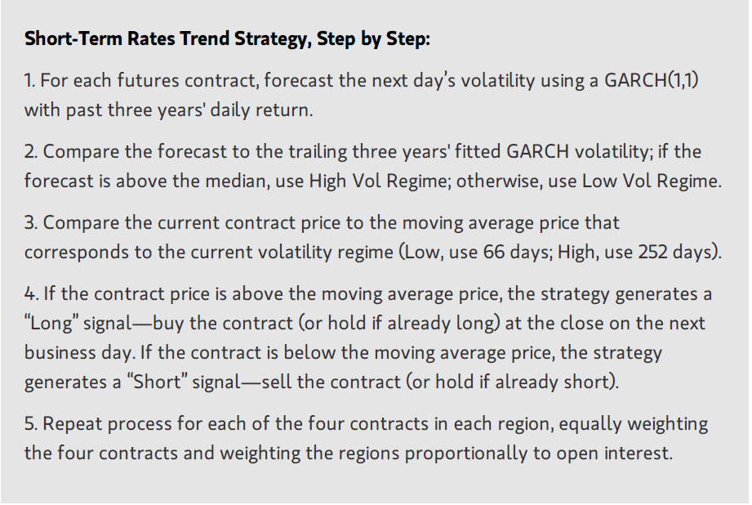
Summary of Strategy

Slide 3
Notes:
Volatility will be calculated based on S&P 500 index.
The strategy compares the median of forecast volatility last three year with the forecast volatility tomorrow to decide whether the volatility regime is high ow low
- if volatility regime is low, it will go long (buy) if price of STIR > moving average price of MA1 days and short if price of STIR < moving average price of MA1 days
- if volatility regime is high, it will go long (buy) if price of STIR > moving average price of MA2 days and short if price of STIR < moving average price of MA2 days
3. The transaction cost is modelled by using the Bid-Ask price for S&P e-mini future contracts. Details are as follows:
- When there is a buy signal, I buy the contract with ask price and when there is a sell signal, I sell the contract with bid price.
- In addition, I also add the commission fee into the transaction cost.

Slide 4
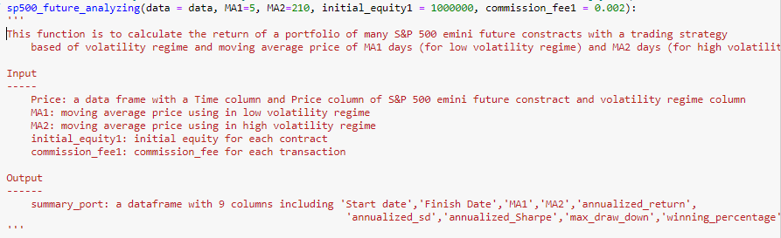
Main functions
sp500_future_analyzing:

Slide 5
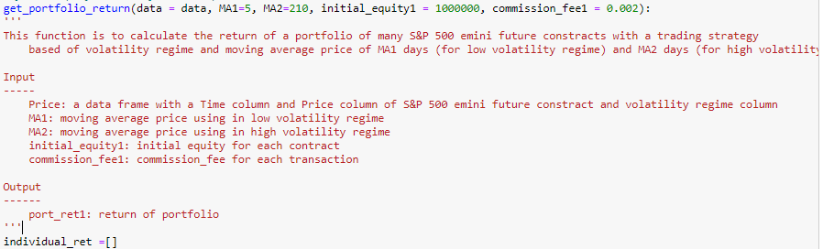
Main functions
get_portfolio_return:

Slide 6
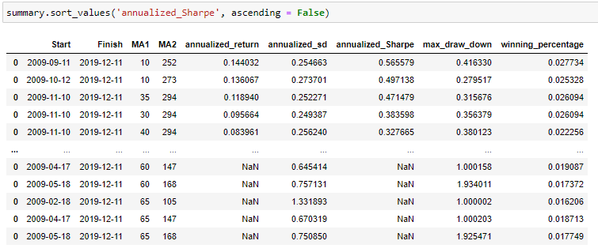
1. run grid-search with changes of MA1 ( fast-moving window) and MA2 (slow-moving window) to see how these parameters affect the Sharpe ratio
Notes:
Remember to talk about P-value

Slide 7
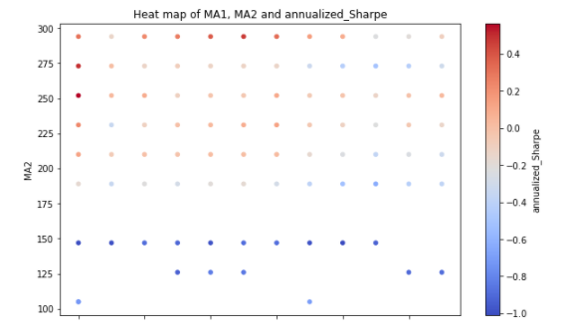
1. run grid-search with changes of MA1 ( fast-moving window) and MA2 (slow-moving window) to see how these parameters affect the Sharpe ratio
Notes:
Remember to talk about P-value

Slide 8
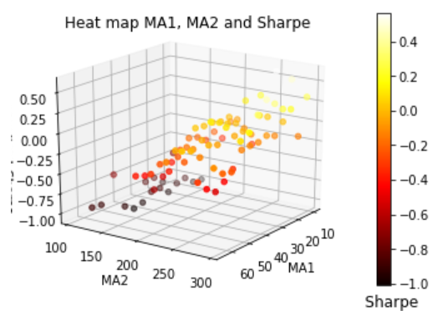
For easier to imagination, I created a 3d heat map
It can be seen that MA1 = 5 days and MA2 moves in a range from 200 - 300 days tends to produce highest Sharpe ratio
Notes:
Remember to talk about P-value

Slide 9
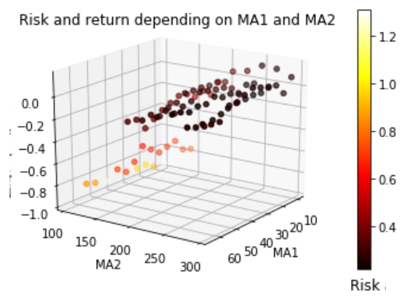
2. How changes in MA1 and MA2 affect risk and return profile?
Notes:
Remember to talk about P-value

Slide 10
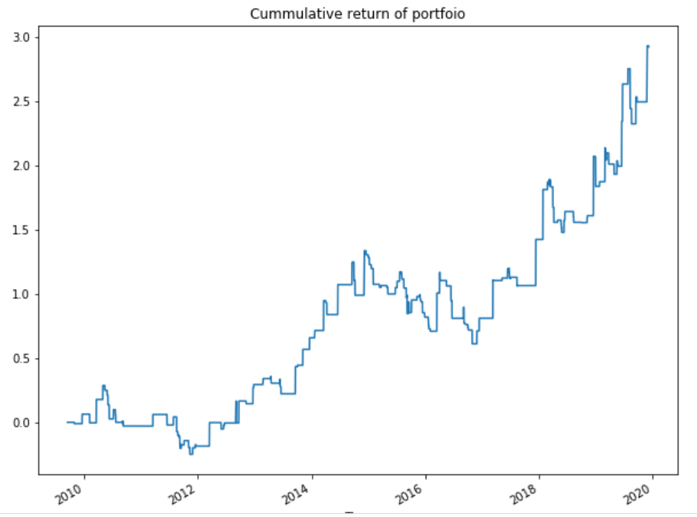
3. Analyse the performance of max Sharpe case (MA1 = 10, MA2 = 252, Sharpe = 0.56 )
Notes:
Remember to talk about P-value

Slide 11
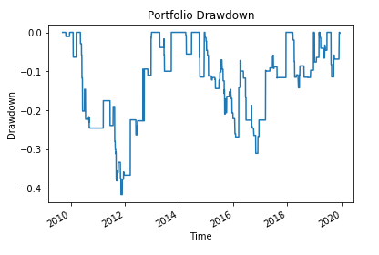
Notes:
Remember to talk about P-value

Slide 12
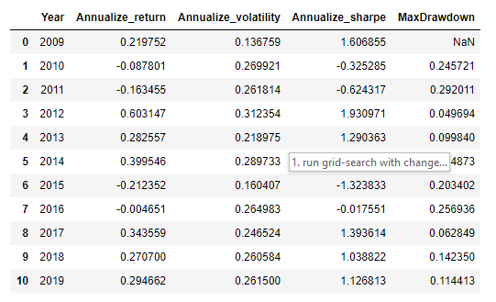
Performance Summary in years:
Notes:
Building Strategy:
The model represents a mathematical specication of the
trading strategy. There are two important considerations in
this specication: the selection of which factors and how
these factors are combined. Both considerations need to be
motivated by the economic intuition behind the trading
strategy.
Evaluating, Backtesting, and Implementing the Strategy:
The nal step involves assessing the estimation, specication,
and forecasting quality of the model. This analysis includes
examining the goodness of t (often done in sample),
forecasting ability (often done out of sample), and sensitivity
and risk characteristics of the model.

Slide 13
